Slide 1

Highlight Format Template
Scientific Achievement
Text that presents what was learned, not what was done
All green text should be RGB = 15, 102, 54 (consistent with the SC webpage: (https://science.osti.gov/About/Resources/Logos#ColorVariations)
IMAGE(S)
c
Significance and Impact
Identify why the achievement is important
Research Details
  Bulleted list of what was done
Figure caption
Reference(s)
Acknowledge user facilities if appropriate
Notes:
1-2 paragraph description of highlight – NOT the abstract of the paper… more like talking points for a speaker using the slide that summarize the most important aspects.
Acknowledgements – From the paper, with additional info if the acknowledgement is not sufficient.
Publication/ press releases/ related links

Slide 2
How to Build a DOE Basic Energy Sciences Highlight Slide
Purpose
  Convey current scientific and technical research results in a way that is intriguing, succinct, relevant, and easily understood by both technical and non-technical communities.
Use
  Information can be employed and adapted for multiple uses, including meetings with other federal agencies, review committees, scientific panels, and budget meetings.
  Highlight text can also be a critical component of annual budget request documents that are reviewed by DOE senior leadership and Congress.
Needs
  It is exceptionally important to convey the importance or significance the research has on the particular research field.
  A standard format for scientific highlights helps the Office of Science to efficiently and effectively communicate research results to the public.

Slide 3
How to Build a DOE Basic Energy Sciences Highlight Slide
Submission
  Highlights should be submitted regularly to your Point of Contact (POC). In general, highlights should focus on a published, or soon to be published, paper. Information on publication timing, should be shared (in writing). Highlights involving sensitive information that would compromise patents, for example, should be shared via secure means, not as a highlight slide.
  Send your POC a copy the published paper (if available) or preprint if not yet published with the highlight.
  If your institution has a press release (or planned press release), please forward to your POC.
  All graphics should be clear and large enough to be easily viewed. Keep resolution of the embedded graphic in mind.
  Well crafted highlight slides may be presented by many different people with many different science backgrounds!

Slide 4
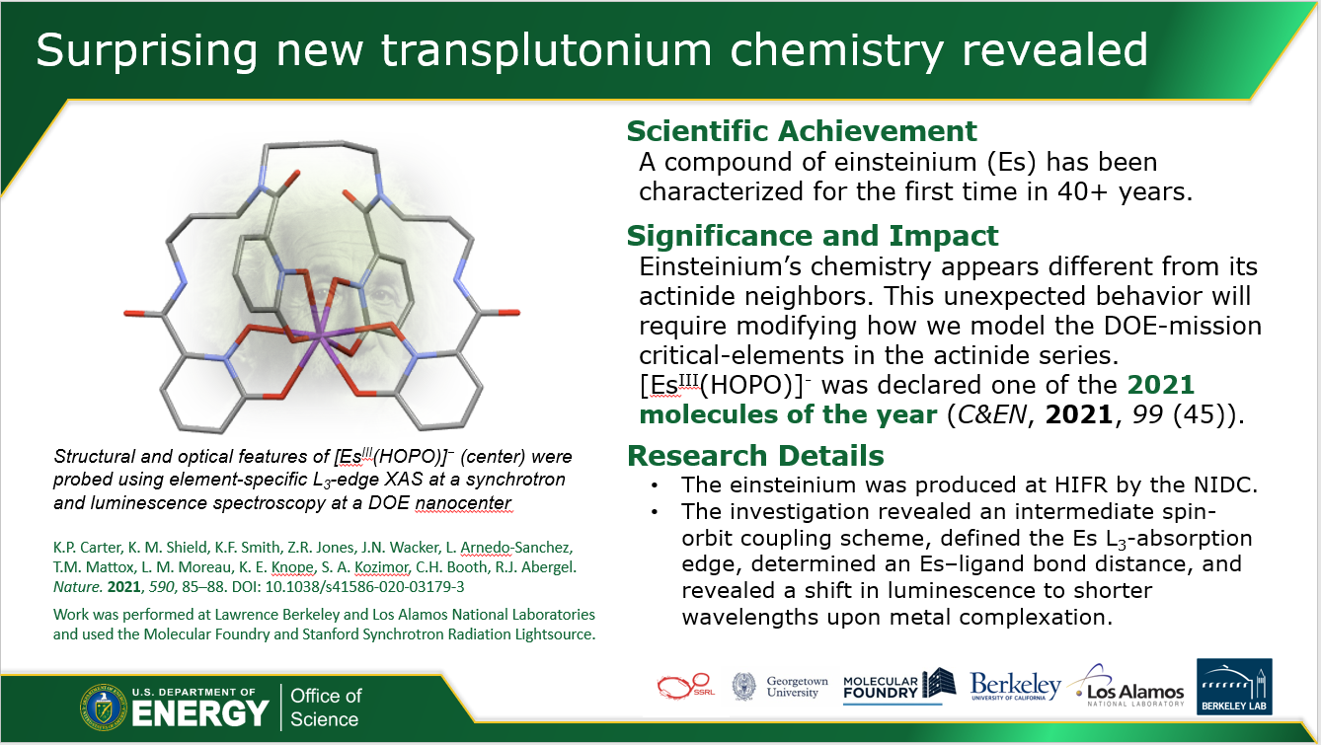
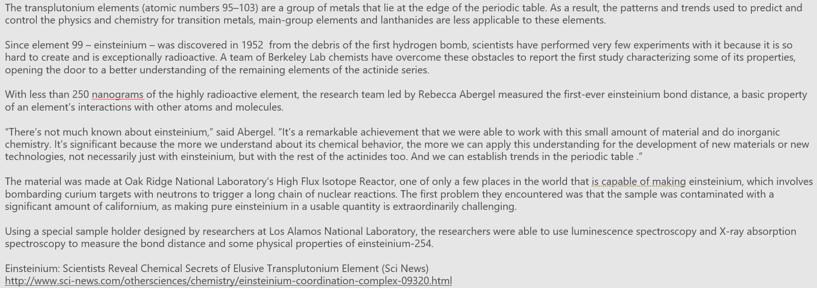
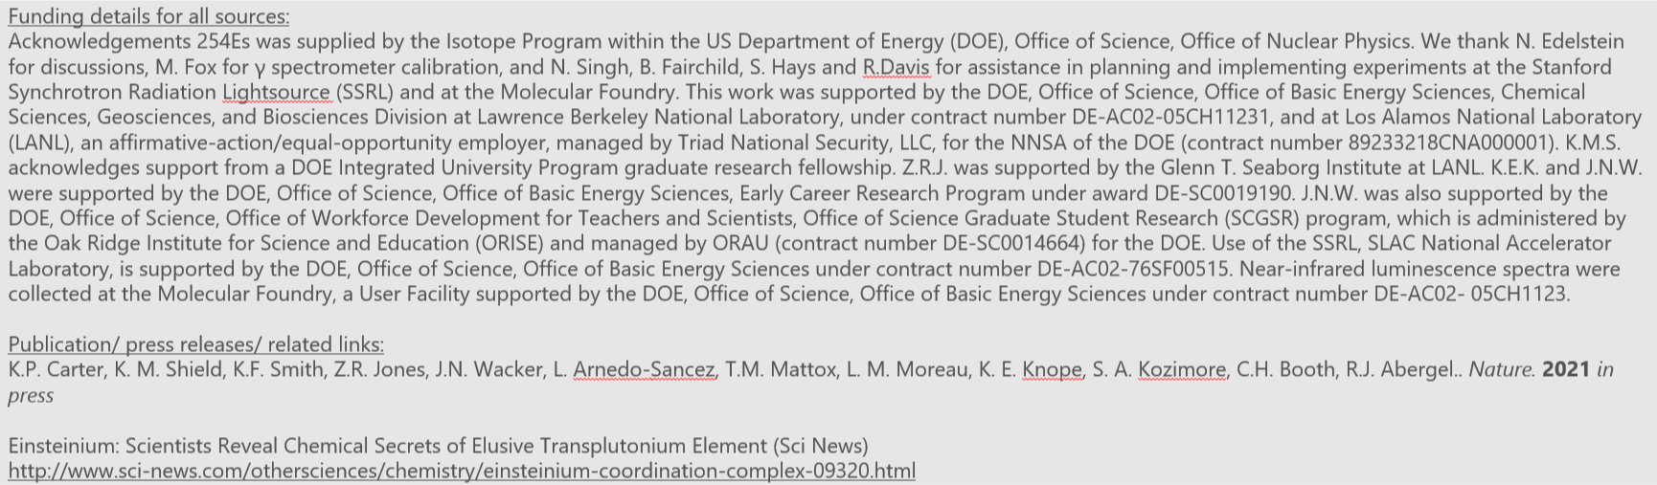
How to Build a DOE Basic Energy Sciences Highlight Slide
Title
Attention grabbing and accessible but not exaggerated
Text
All text should be short and to the point –
minimize words and stress significance to society
  Scientific Achievement – 50 words or less
  Significance and Impact – 50 words or less
  Importance, relevance, or intriguing component of the finding to the field
  Research Details – Address the research approach in 2-4 bullet points
  Citation - Full citation with DOI is preferable
PowerPoint Notes
Give a 1-2 paragraph detailed explanation with acknowledgements and optional related links
Sponsor delineation of work should be made clear here, and reflect acknowledgements/credit lines

Slide 5
How to Build a DOE Basic Energy Sciences Highlight Slide
Figures
  Visually compelling figure(s) to explain the research
  Include legends and descriptive caption
DOE has the right to use published journal images per contractual funding agreements
Institutional logo(s)
  Include affiliations or institutional logos
  Indicate institution where research was performed (if possible)
  EFRC and Hub research should include those logos as well

