Slide 1
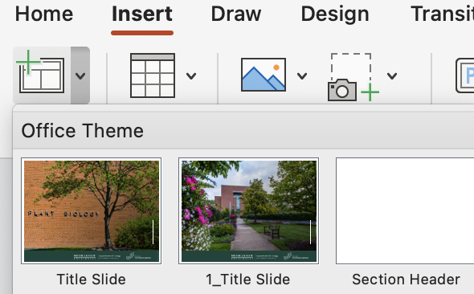
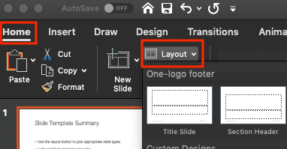
Slide Template Instruction
Use the Layout button to choose the appropriate slide type.
On Mac: Insert → New Slide→ click on the layout you want in the slide panel.
On Win: Home → Layout → click on the layout you want in the slide panel.

Slide 2
Slide Template Summary
This template includes the following slide types:
Cover Pages
Section Header & (Sub) Titles
Content Page
Tiles and Content
Kindly remove this page before usage.

Slide 3
1. Cover Pages

Slide 4
COVER PAGE #1.1
Without photos
Add author information here

Slide 5
COVER PAGE #1.2
Without photos (Dark)

Slide 6
COVER PAGE #2 with full, static image and three lines of text

Slide 7
COVER PAGE #3 with full, static image and three lines of text

Slide 8
COVER PAGE #4 with full, static image and three lines of text

Slide 9
COVER PAGE #5 with full, static image and three lines of text

Slide 10
2. Section Header & (Sub) Titles

Slide 11
Section Header #1 with a full, static image and four lines of text

Slide 12
Section Header #1 with a full, static image and four lines of text

Slide 13
Section Header #3 a full, static image and four lines of text

Slide 14
Section Header #4 with a full, static image and four lines of text

Slide 15
Section Header#5 with a full, static image and two lines of text

Slide 16
Section Header #6 without photos

Slide 17
3. Content Page

Slide 18
Content (Example)
Background
Approaches
Results

Slide 19
Content
Background
Approaches
Results

Slide 22
4. Blank Pages

